Slide 1
Warm-Up What are the three types of RNA? What jobs do they have in protein synthesis?

Slide 2
Warm-Up Between the two processes of mitosis and meiosis, which is asexual reproduction and which is sexual reproduction?

Slide 3
Warm-Up Get out your “Cell Differentiation” Activity.

Slide 4
Warm-Up Study for the midterm

Slide 5
Warm-Up Study for the Quiz.

Slide 6
Sexual reproduction and
Meiosis
Wake County
Biology Curriculum

Slide 7
REVIEW
Asexual Reproduction
Reproduction with only one parent (mitosis)
Single celled organisms reproduce by mitosis.

Slide 8
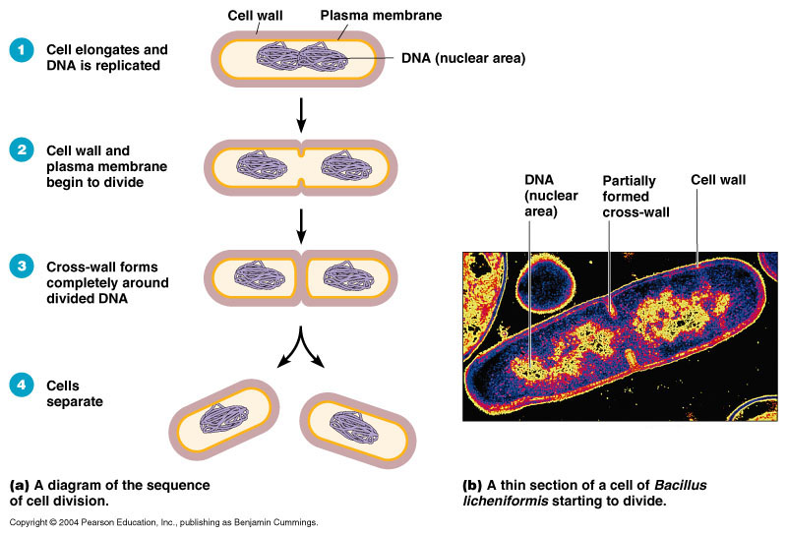

Slide 9
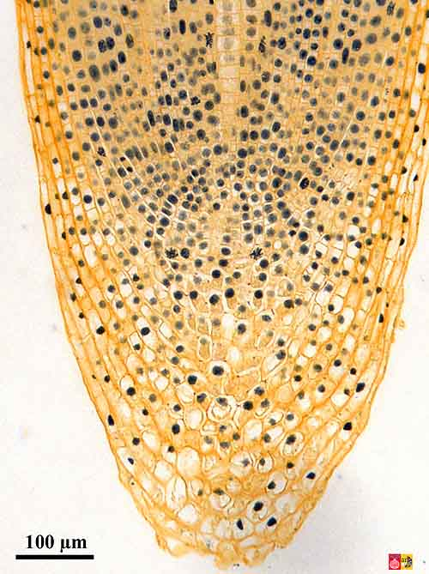
Mitosis creates new somatic (body) cells.
Growth
www.vcbio.science.ru.nl

Slide 10
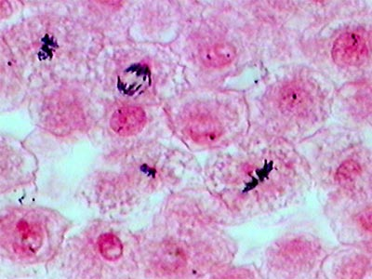
Mitosis creates new somatic (body) cells.
White fish blastula (embryo)
www.doctortee.com

Slide 11
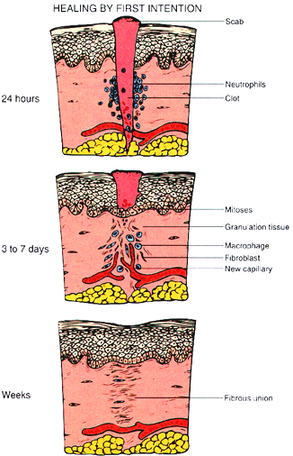
Mitosis makes cells for repair.
medicinembbs.blogspot.com

Slide 12
Sexual reproduction is different!

Slide 13
Sexual Reproduction
Reproduction that requires two parents (meiosis)

Slide 14
Sexual Reproduction (continued)
Reproductive cells form (egg and sperm)
The process that forms egg and sperm cells is called MEIOSIS

Slide 15
Meiosis
Chromosomes
Occur in pairs in the body cells of animals and most plants
A full set of chromosomes is said to be diploid (one pair of each type of chromosome)

Slide 16
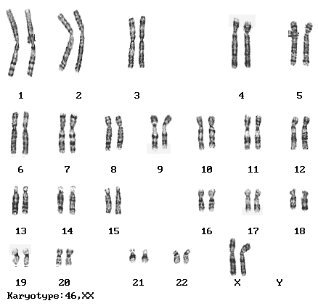
www.biology.iupui.edu
Diploid cells have two of every kind of chromosome. Humans have 23 pair that are all different.

Slide 17
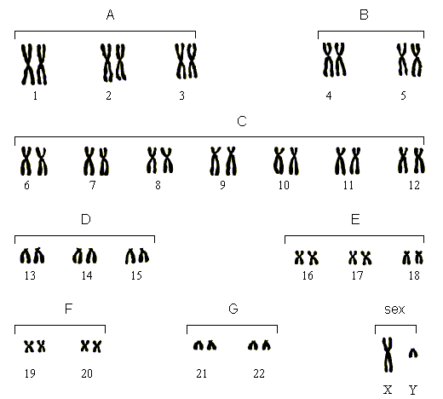
G₁
During G₁, you have individual chromatids.
www.biology.iupui.edu
G₂
www.web-books.com

Slide 18
G₁
During G2, after replication each chromatid has an identical sister chromatid attached by a structure called a centromere.
www.biology.iupui.edu
G₂
www.web-books.com

Slide 19
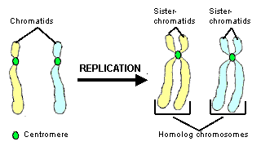
vcbio.science.ru.nl

Slide 20
This is one diploid pair of homologous chromosomes.

Slide 22
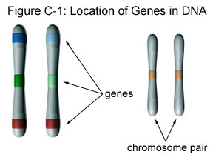
Genes are located in the same spot on the chromosome. Therefore you have two genes for every trait.
They are
basically
the same
but differ
in small
ways.

Slide 23
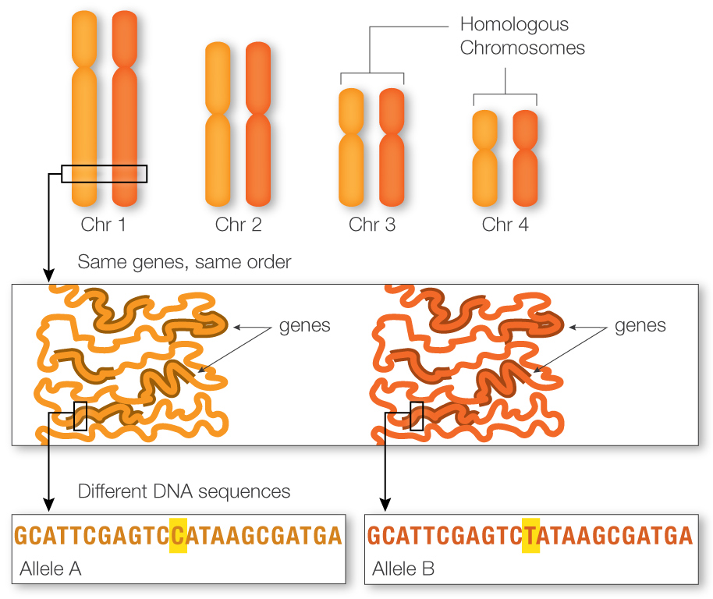

Slide 24
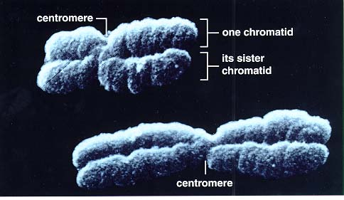
uic.edu

Slide 25
There is one pair of sex-chromosomes or a pair which determine the gender of the organism.

Slide 26
And there are twenty-two (22) pair of autosomes or chromosomes other than sex-chromosomes.

Slide 27
Why is it important to have half a set of chromosomes?
When an egg and sperm cell get together during fertilization, two half sets make one whole set of 23 homologous pairs.
Therefore, egg and sperm cells must be haploid.

Slide 28
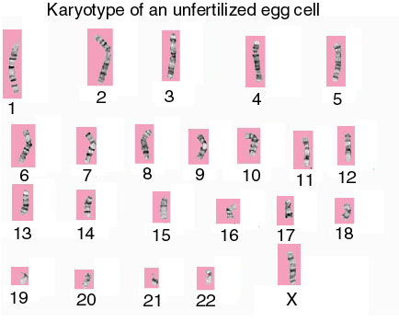
Half of a set of chromosomes is said to be haploid. Only one of each pair
course1.winona.edu

Slide 29
Meiosis
Is the process by which the number of chromosomes in a cell is cut in half to produce sex cells (egg and sperm)

Slide 30
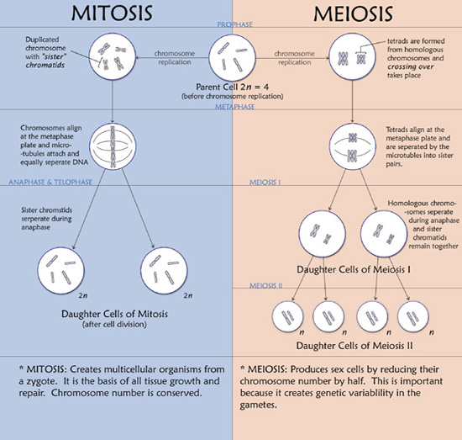
www.albinoburmese.com

Slide 31
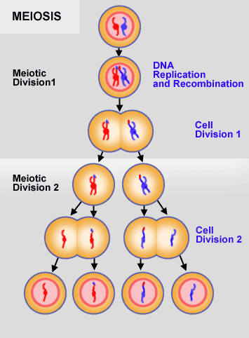
dbscience3.wikispaces.com

Slide 32
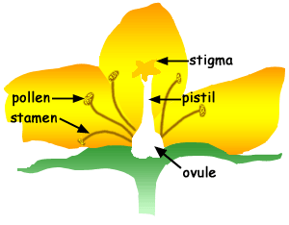
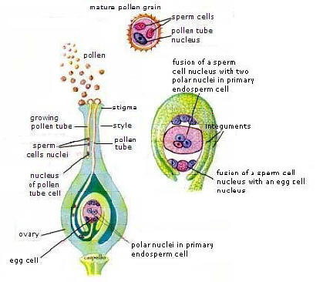
Mitosis: makes all body cells.
Meiosis: makes
g p
g e
r
m
cells
mbgnet.net
technologyofbiology.bl...

Slide 33
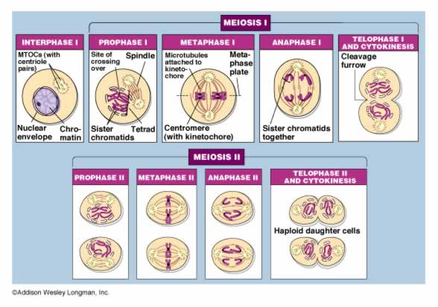

Slide 34
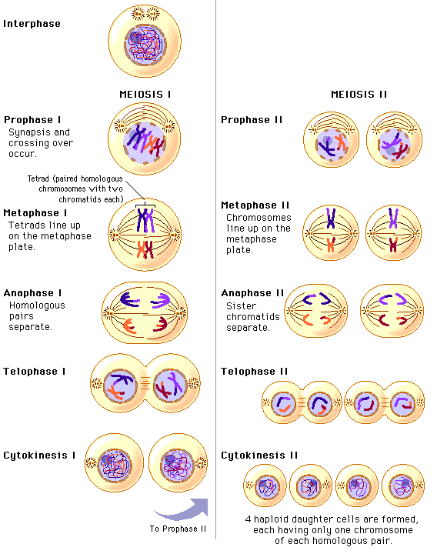
www.phschool.com

Slide 35
Meiosis goes through the stages of mitosis twice without going through interphase S (chromosome replication) in between the two processes.

Slide 36
Interphase
The cell replicates the chromosomes
The new chromosomes are sister chromatids held together by a centromere

Slide 37
II. Prophase I
The pairs of sister chromatids come together with their homologous chromosomes to form a tetrad (4 chromatids)

Slide 39
Prophase I
Crossing over occurs at this time with pieces of chromosomes exchanging places with other pieces of chromosomes.
In mitosis, only the pairs of sister chromatids are together

Slide 40
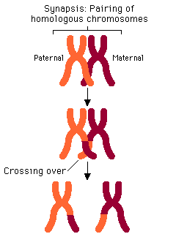
TETRAD

Slide 41
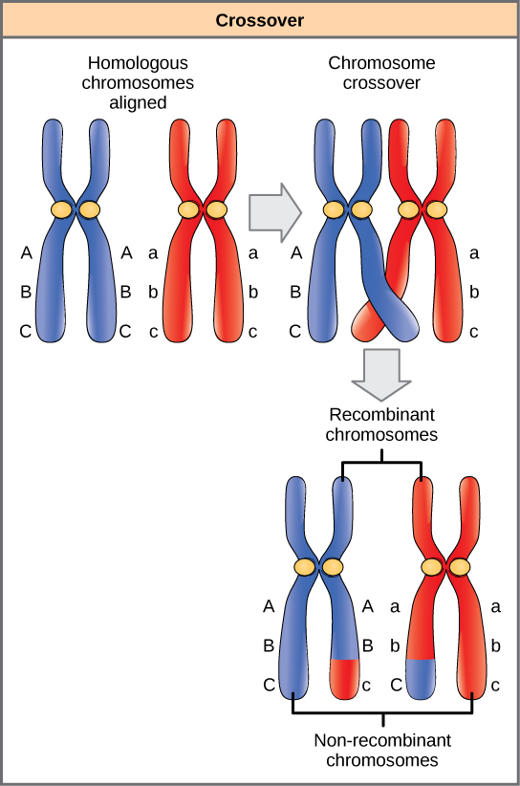

Slide 42
III. Metaphase I
The tetrads line up at the equator
In mitosis, only the pairs of sister chromatids line up

Slide 43
IV. Anaphase I
The homologous chromosomes separate
The sister chromatids are still attached to each other

Slide 44
V. Telophase I
The two new cells split
Now the sister chromatids need to separate
C. Interphase is short with no chromosome replication

Slide 45
VI. Prophase II
New spindle fibers form in both new cells

Slide 46
V. Metaphase II
The sister chromatids, still attached, line up at the equator

Slide 47
VI. Anaphase II
The sister chromatids separate and are pulled to each end of the cells

Slide 48
VII. Telophase II
Each cell splits to form two more cells
This makes a total of four gametes which are all haploid.
This means they have half the chromosomes they are supposed to have.

Slide 49
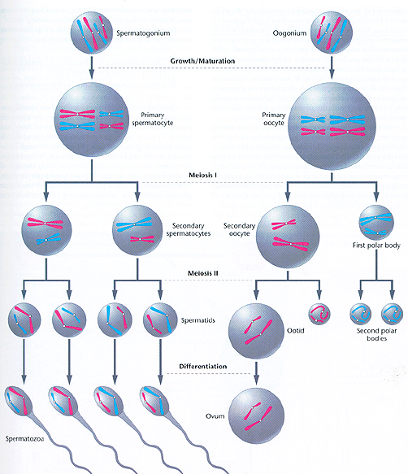
www.bio.miami.edu

Slide 50
When an egg and a sperm get together the resulting cell is called a zygote.
This cell is now diploid again with a full set of chromosomes.
The zygote will grow into an embryo.
If meiosis did not occur before fertilization, cells would have twice the DNA than they are supposed to.

Slide 51
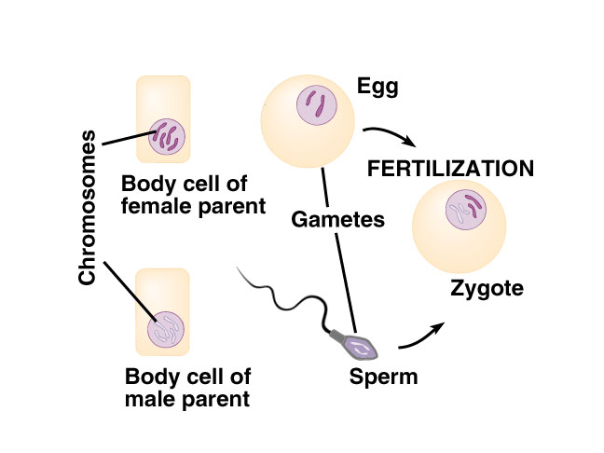
diploid cells haploid diploid again
iws.collin.edu

Slide 52
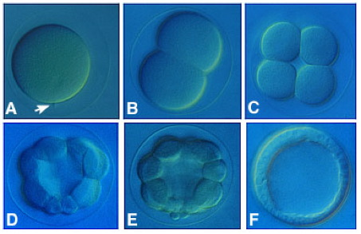
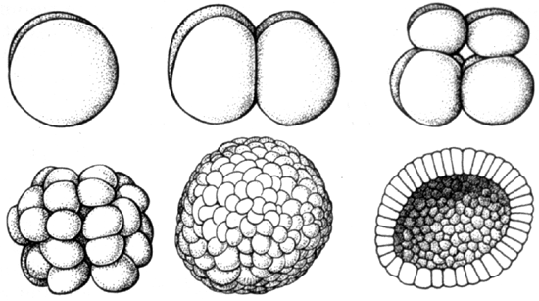
Early Development
Then through cell division (mitosis), the zygote becomes a blastula.
worms.zoology.wisc.edu
blastula
www.geol.umd.edu

Slide 53
Early Development
The cells of the blastula are embryonic stem cells.
Stem Cells are unspecialized cells. This means they have not yet differentiated to build different tissues that make the body of the organism.

Slide 54
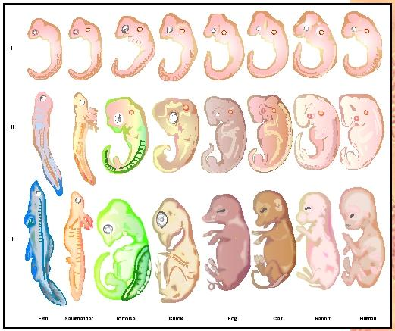
At this step, each species tissues start to differentiate depending on evolutionary development.
https://bealbio.wikispaces.com

Slide 55
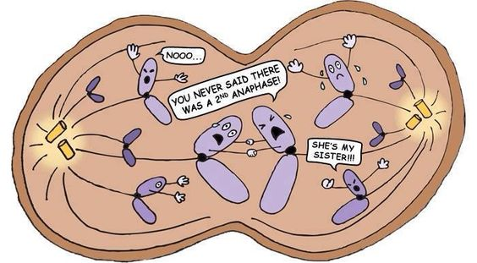

Slide 57
