Slide 1
Warm-Up
Why is a basic understanding of chemistry important when studying biology?

Slide 2
Warm-Up
Of what elements are you made? Of what molecules are you made?

Slide 3
Warm-Up
What is condensation? What macromolecule is formed by bonding amino acids in this process? What by-product is formed?

Slide 4
Warm-Up
Compare and contrast organic and inorganic molecules.

Slide 5
Warm-Up
Study for Unit 1 Test

Slide 6
Warm-Up
Make sure Unit 1 Review is complete.

Slide 7
Warm-Up
What is a monomer? What is the monomer called for carbohydrates, proteins, and nucleic acids? What is a polymer?
Pass them up.

Slide 8
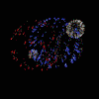
Essential Standard
4.1.1 Compare the structures and functions of the major biological molecules (carbohydrates, proteins, lipids, and nucleic acids) as related to the survival of living organisms.

Slide 9
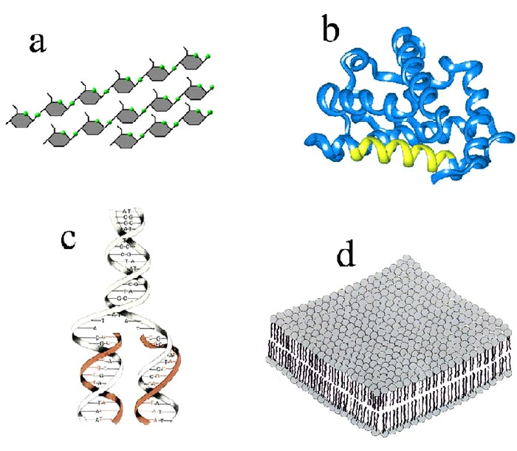
edtech2.boisestate.edu

Slide 10
Organic VS Inorganic Molecules
Organic Molecules – are molecules made with carbon as one of the components.
Examples: proteins, lipids (fats and oils), carbohydrates, and nucleic acids
Inorganic Molecules – do not contain carbon
Examples – water, salts, etc…

Slide 11
Macromolecules
Means “giant molecules”
Formed in a process called condensation. (Also known as polymerization)

Slide 12
Macromolecules
Carbon creates long complex molecules because of the many types of bonds that it creates and the many different compounds that it can bond with.

Slide 13
Four Molecules of Life
Proteins:
Are polymers (“many units”) made of monomers (“single units”) called amino acids
Amino acids are made of made up of carbon, hydrogen, oxygen and nitrogen (sometimes sulphur)

Slide 14
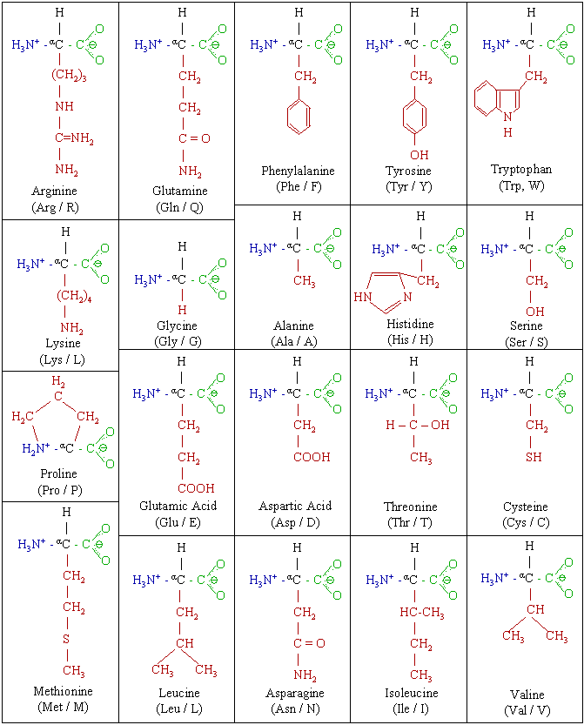
Four Molecules of Life
Proteins (continued):
Are made of amino acids that are made of carbon, hydrogen, oxygen, nitrogen, and some sulfur.
C, H, O, N, S
www.teachersparadise.com

Slide 15
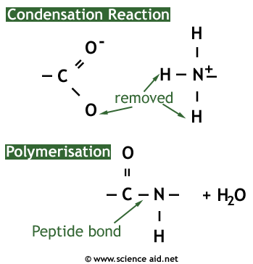
Four Molecules of Life
Proteins (continued): Structure
A water molecule is kicked out.

Slide 16
Four Molecules of Life
Proteins (continued): Structure
Amino acids in proteins are held together by peptide bonds

Slide 17
Peptide Bonds
A peptide bond is a covalent bond formed between two amino acids
www.mmabangout.com

Slide 18
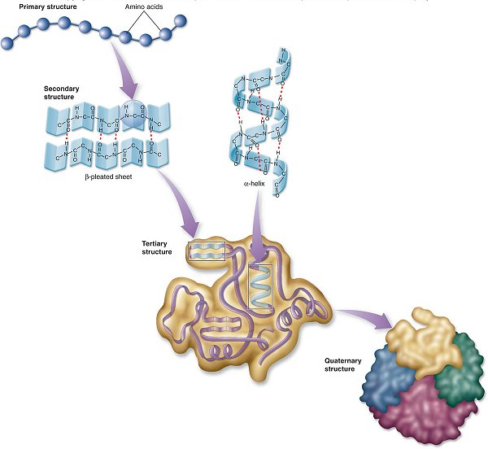
As the protein chain is made, it begins to fold into a three dimensional structure.
www.yellowtang.org

Slide 19
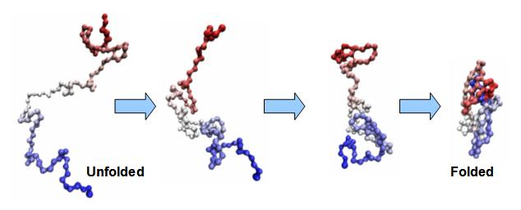
cnx.org

Slide 20
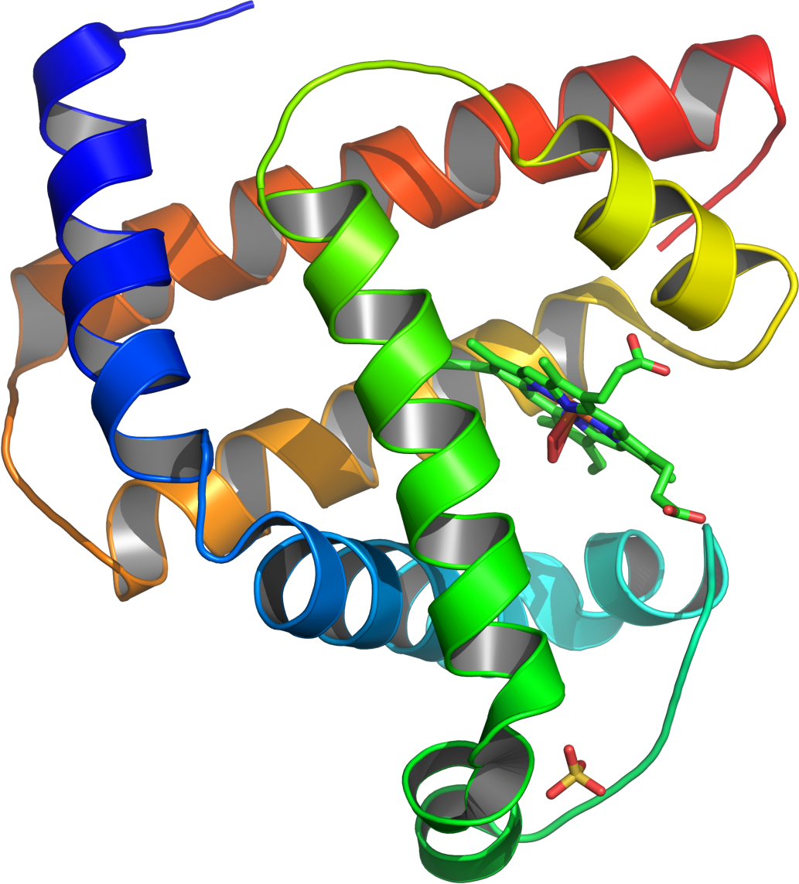
wikipedia.org

Slide 21
Four Molecules of Life
Proteins (continued):
Have many functions
1) Proteins build tissues of the body.
2) They maintain and replace damaged tissues.
3) They carry out regulating activities as enzymes and hormones.

Slide 22
Four Molecules of Life
Proteins (continued):
4) They are protective as antibodies.
5) They help in other important activities such as movement of skeletal muscles, transport of oxygen, pigmentation of skin, etc.
6) Hemoglobin carries oxygen in blood

Slide 23
Four Molecules of Life
Carbohydrate:
Includes sugars, starches, cellulose, and glycogen
Starches are polymers, or polysaccharides, made of monomers called monosaccharides
Disaccharide is two monomers joined

Slide 24
Four Molecules of Life
Carbohydrate (continued):
Includes the elements of carbon, hydrogen, and oxygen.
Usually found in the following ratio:C₁H₂O₁ OR 1 : 2 : 1
Glucose is C₆H₁₂O₆
Sugars and starches are used as food

Slide 25
Condensation to form
Disaccharide
Monosaccharides
Carbohydrates

Slide 26
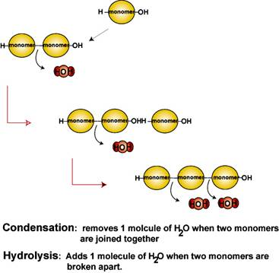

Slide 27
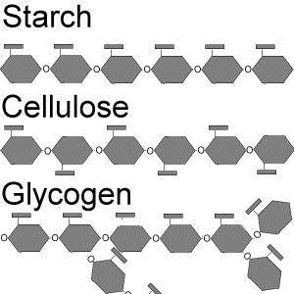
bioweb.wku.edu

Slide 28
Four Molecules of Life
Lipids – Fats and Oils:
Lipids do not dissolve in water
Are polymers made of chains of carbons with many hydrogens attached and just a few oxygens

Slide 29
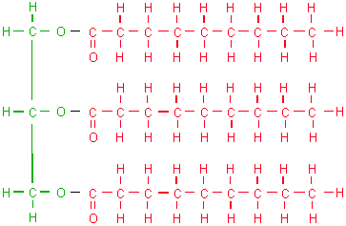
Triglyceride
Formed from a glycerol and three fatty acids.
faculty.clintoncc.suny.edu

Slide 30
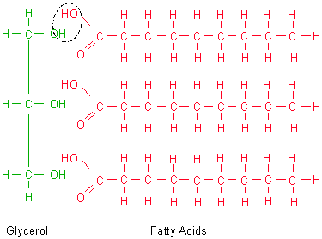
When fats join, water is kicked out. This is why the process is called condensation.
faculty.clintoncc.suny.edu/

Slide 31
Triglyceride
faculty.clintoncc.suny.edu

Slide 32
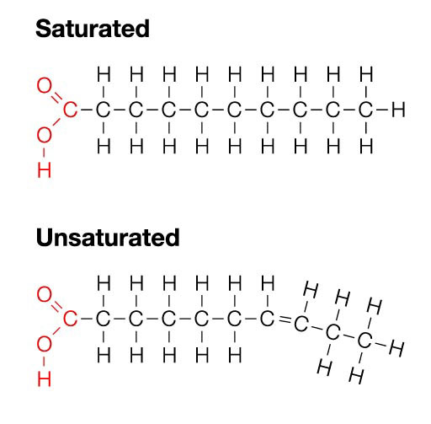
The more hydrogens there are, the more saturated a fat becomes.
www.realfitnessblog.com

Slide 33
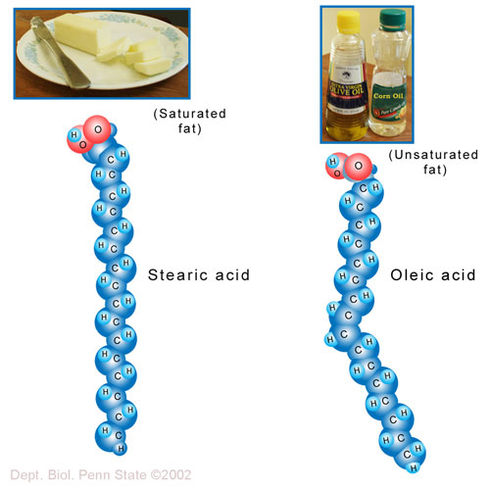

Slide 34
Four Molecules of Life
Lipids – Fats and Oils:
Lipids are used by organisms to store energy
Lipids are the main component of cell membranes.
Lipids make-up cell membranes in the form of phospholipids

Slide 35
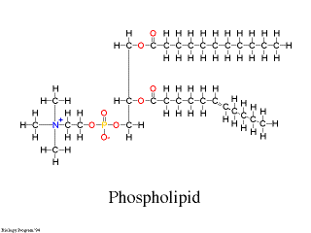
Uses of Lipids
Instead of three fatty acids there are only two. The place of the third fatty acid is taken by a phosphate group.
web.nestucca.k12.or.us/

Slide 36
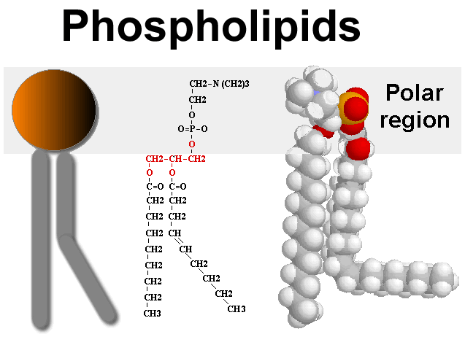
Uses of Lipids
Instead of three fatty acids there are only two. The place of the third fatty acid is taken by a phosphate group.
bioweb.wku.edu

Slide 37
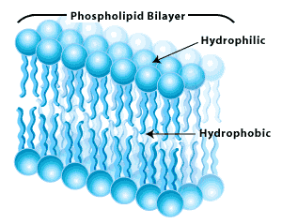
images-mediawiki-sites.thefullwiki.org

Slide 38
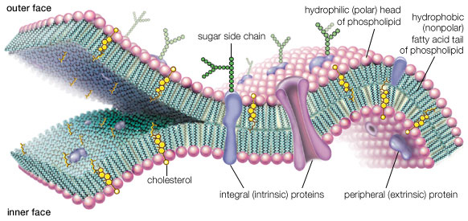
Phospholipid bilayer structure of a cell membrane. You will learn all the other parts later.
anatomysblueprint.com

Slide 39
Four Molecules of Life
Nucleic Acid:
Includes DNA and RNA
DNA is used to store all the information an organism needs for growth, development and survival
RNA is used to produce proteins in an organism

Slide 40
Four Molecules of Life
Nucleic Acid (continued):
DNA and RNA are polymers made of monomers called nucleotides
Nucleotides are made of carbon, hydrogen, oxygen, phosphorus and nitrogen

Slide 41
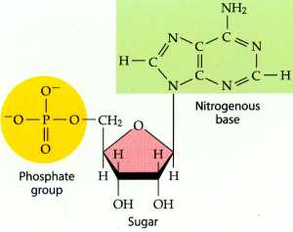
Structure of a Nucleotide
4.bp.blogspot.com

Slide 42
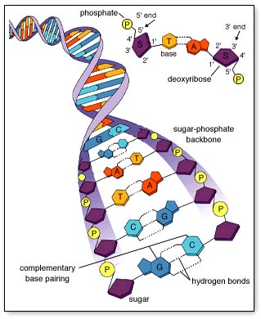
Nucleotides join in double strands called DNA
Polymer - DNA
Monomer - nucleotide
www.mhhe.com

Slide 43
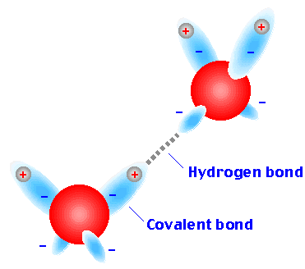
Hydrogen Bonds
Hydrogen bonds are weak bonds formed when covalent molecules have slight negative and positive charges that cause attractions.

Slide 44
Nucleotides are attached by bonds called hydrogen bonds
www.mhhe.com

Slide 45
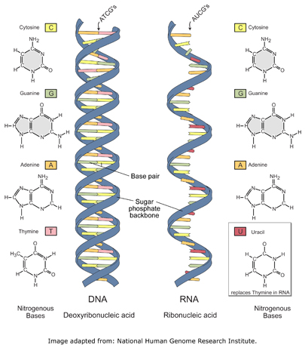

Slide 46
Condensation:
Occurs when monomers join to form chains called polymers.
Gives off water molecules
Occurs in all four of the molecules of life

Slide 47
bcs.whfreeman.com

Slide 48
Hydrolysis:
Occurs when polymers break down into monomers.
Uses water molecules
Occurs in all four molecules of life

Slide 49
bcs.whfreeman.com

Slide 50
Without water, there would be no life

Slide 51
Can you identify all four molecules of life?

Slide 53
What is A?
Carbohydrate

Slide 54
What is B?
Protein

Slide 55
What is C?
Nucleic Acid

Slide 56
What is D?
Lipid

Slide 57
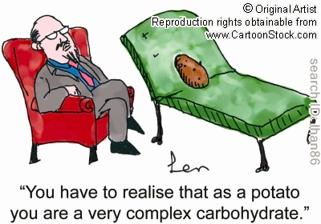

Slide 58
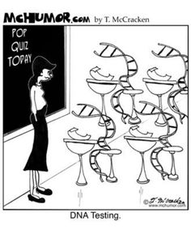

Slide 59
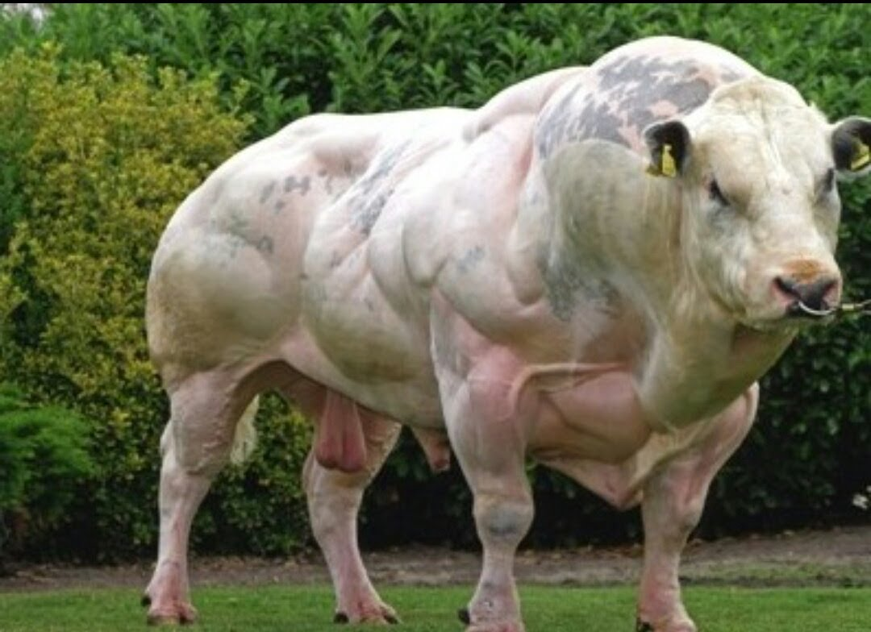
Why would the steak house
be calling me?

