Slide 1
Warm-Up Why do cells need to make copies of their DNA? Why do your cells make copies of DNA?

Slide 2
Warm-Up List and describe the three stages of interphase. Then, list and describe the four stages of mitosis.

Slide 3
Warm-Up What is IPMAT? What does each letter stand for?

Slide 4
Mitosis
Wake County
Biology Curriculum

Slide 5
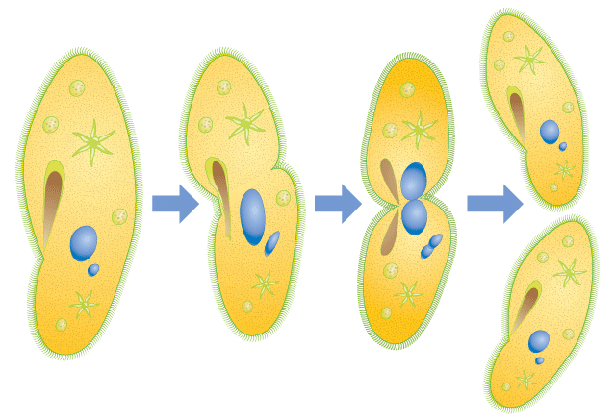
Mitosis: Asexual reproduction of cells. Only one parent; a one celled organism becomes two.

Slide 6
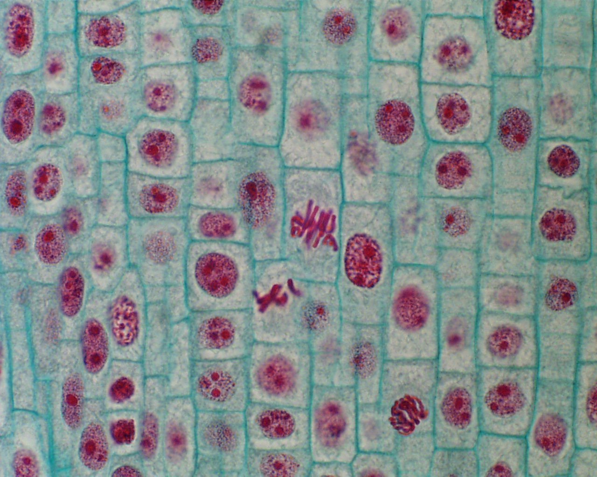
Mitosis: Asexual reproduction of cells. A multicelled organism increases numbers of cells or replaces cells.

Slide 7
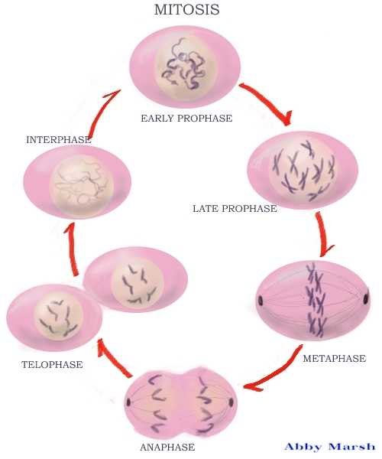
Life-cycle of a cell
schoolworkhelper.net

Slide 8
How do cells divide?
IPMAT
I – interphase (G1, S, G2)
P – prophase
M – metaphase
A – anaphase
T - telophase
Mitosis
8

Slide 9
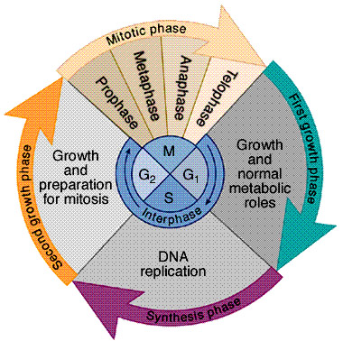
biologycorner.com

Slide 10
Cell Cycle
Interphase:
G₁ is the phase of the cell during which the cell goes through most of it’s growth by getting bigger and increasing organelles.

Slide 11
Cell Cycle
Interphase:
S is the phase of the cell during which the cell replicates the chromosomes. We studied replication earlier.

Slide 12
Cell Cycle
Interphase:
G₂ is the phase of the cell during which the cell produces the organelles it needs to start cell division. Organelles such as spindle fibers, centrioles, and centromeres

Slide 13
biologycorner.com

Slide 14
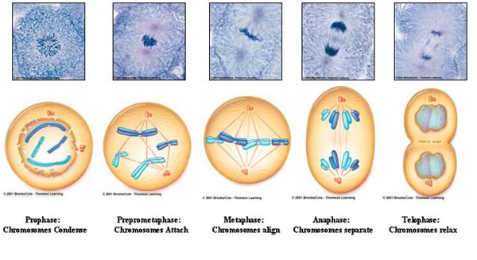
Parent cell: The cell that needs to divide.
Daughter cells: The two new cells formed by mitosis.

Slide 15
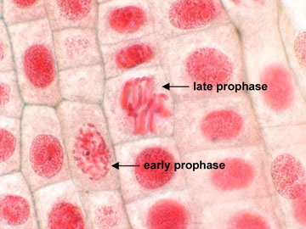
Mitosis
Prophase: nucleus dissolves and chromosomes form from the chromatin
student.ccbcmd.edu

Slide 16
Mitosis
The spindle fibers attach to the centrioles that then stretch them across the cell
student.ccbcmd.edu

Slide 17
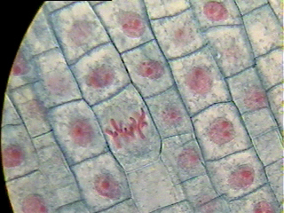
Mitosis
Metaphase: homologous chromosomes attach to the center of spindle fibers stretched across the cell by their centromeres
←metaphase
faculty.marianopolis.edu

Slide 18
Mitosis
The location of the gathered chromosomes is called the cell equator.
←metaphase
faculty.marianopolis.edu

Slide 19
During anaphase, the sister chromosomes are pulled apart at the centromeres. Then each sister chromosome is pulled to opposite ends of the cell.

Slide 20
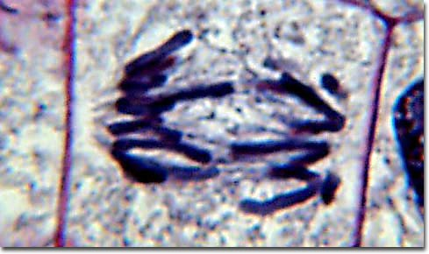
Mitosis
Anaphase: fibers pull the chromatids apart and toward the ends of the cell
micro.magnet.fsu.edu

Slide 21
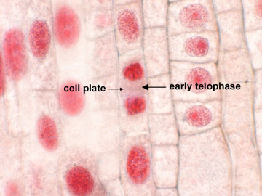
Mitosis
Telophase: last phase during which a nucleus forms around the two new sets of chromosomes and the cell becomes two new cells through cytokinesis
student.ccbcmd.edu

Slide 22
Mitosis
When plant cells go through cytokinesis, a cell plate forms between the two new cells.
student.ccbcmd.edu

Slide 23
Mitosis
When animal cells go through cytokinesis, the cells divide by a process called
cleavage.
student.ccbcmd.edu

Slide 24
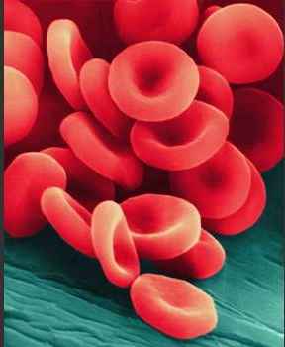
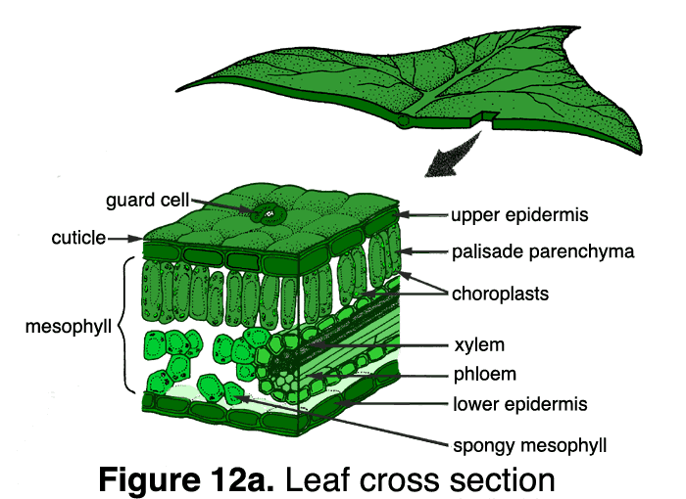
Mitosis
After cytokinesis, cells begin the cell cycle again.
They are now in early interphase with one set of DNA, half the organelles, and half the size.
During interphase, cells double their DNA, increase their organelles, grow, and do their job.
singularityhub.com
extension.oregonstate.edu

Slide 26
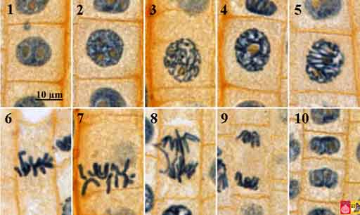
www.blackspvbiology

Slide 27
How do cells divide?
IPMAT
I – interphase (G1, S, G2)
P – prophase
M – metaphase
A – anaphase
T - telophase
Mitosis
27

Slide 28
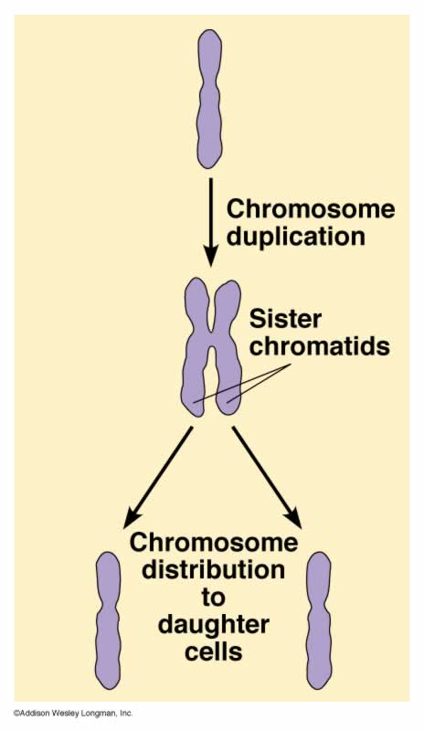
After DNA replication, the cell now has two sets of chromosomes so that when the cell divides, both new cells have their own set of chromosomes.

Slide 29
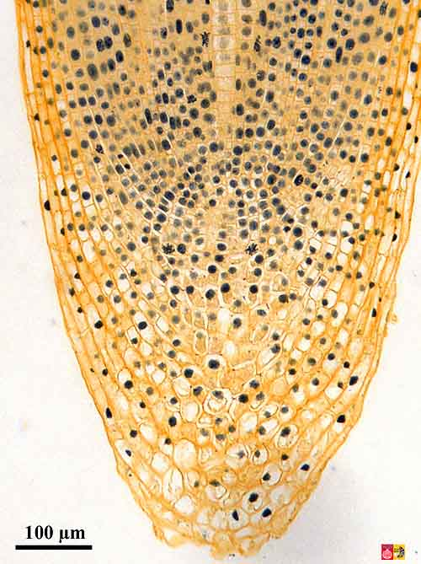
Mitosis creates new somatic (body) cells.
Growth
www.vcbio.science.ru.nl

Slide 30
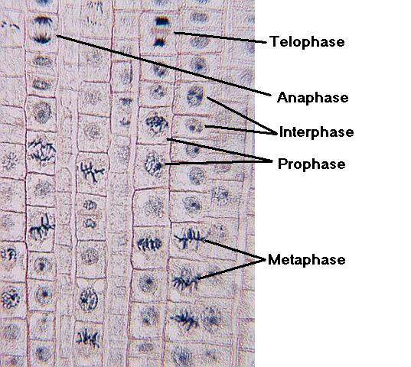
Mitosis creates new somatic (body) cells.
www.eastcentral.edu

Slide 31
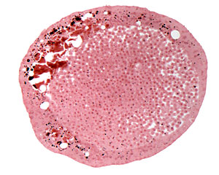
Mitosis creates new somatic (body) cells.
White fish blastula (embryo)
faculty.baruch.cuny.edu

Slide 32
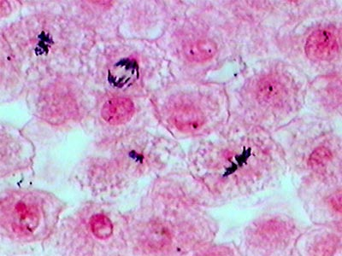
Mitosis creates new somatic (body) cells.
White fish blastula (embryo)
www.doctortee.com

Slide 33
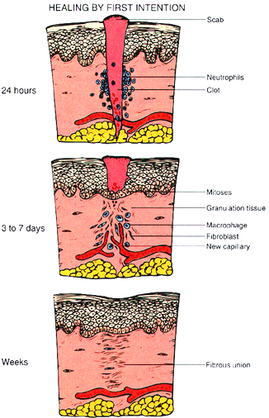
Mitosis makes cells for repair.
medicinembbs.blogspot.com

Slide 34
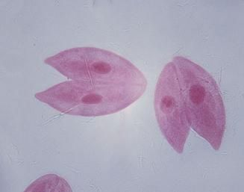
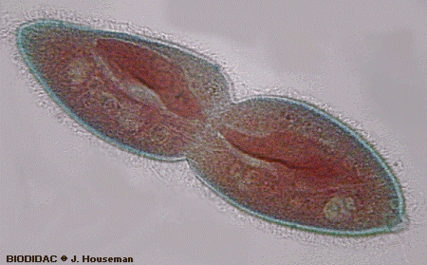
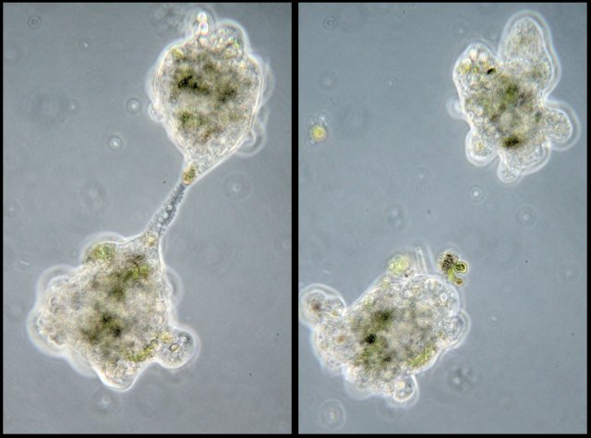
Mitosis makes asexual reproduction possible.
www.buzzle.com
www.photomacrography1.net

Slide 35
Cytokinesis with new cell plate
eastcentral.edu

Slide 36
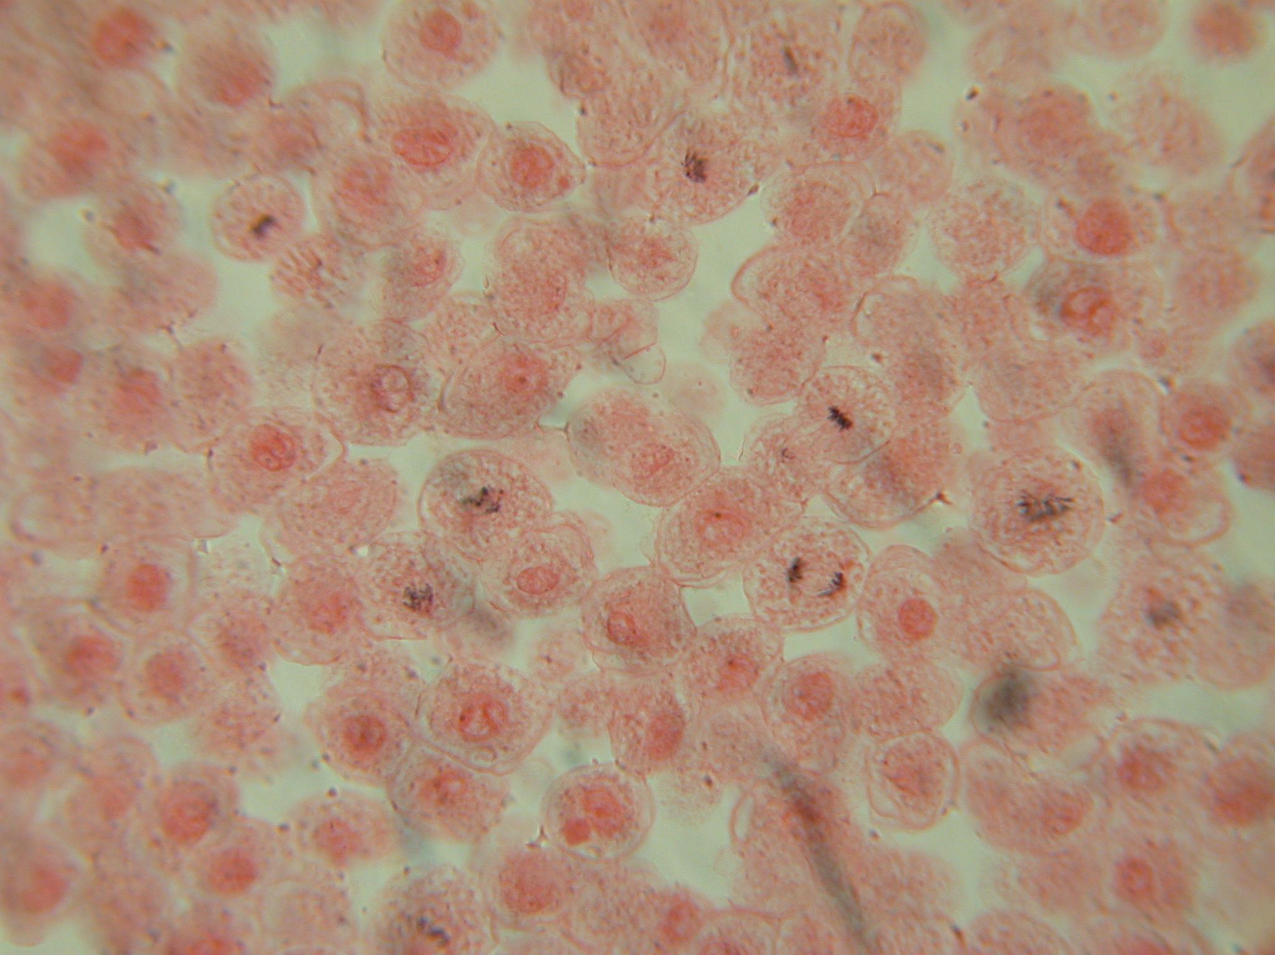
Prophase
Interphase
Metaphase
Telophase and cytokinesis
Anaphase
faculty.umb.edu

Slide 38
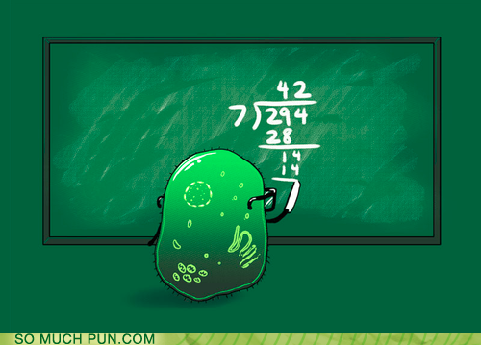
Cell Division

Slide 39
