Slide 1
Warm-Up
What is DNA? Why should we study DNA?

Slide 2
Warm-Up
For what discovery is Watson and Crick famous?

Slide 3
Warm-Up
Study for the benchmark.

Slide 4
Warm-Up
What is DNA? How does it control the person you become?

Slide 5
Warm-Up
What benefits do we get by studying DNA? List and DESCRIBE two examples

Slide 6
Warm-Up
What are the three parts of a nucleotide? List the different nucleotides for DNA and RNA?

Slide 7
DNA
deoxyribonucleic acid
History and Structure
Wake County
Biology Curriculum

Slide 8
What are you going to learn in this unit?
The first part is going to be about DNA and how it works to build organisms.
https://www.youtube.com/watch?v=zwibgNGe4aY
by Stated Clearly

Slide 9
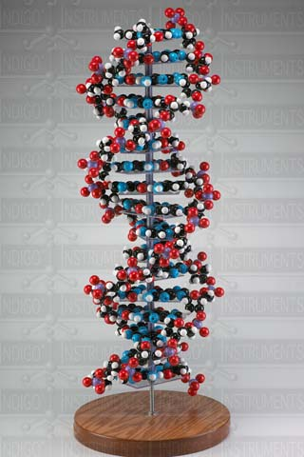
James Watson and Francis Crick
In 1953, Watson and Crick proposed the double helix structure of a DNA molecule
www.indigo.com/images/product/91.jpg

Slide 10
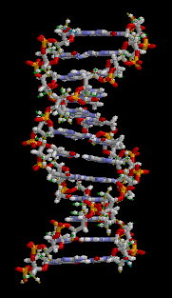
Double-Helix Model

Slide 11
Since its discovery, nucleic acids, or DNA, has been found to control all structure and function of every living organism on the planet. Everything from the simplest bacteria to the giant blue whale.

Slide 12
DNA is a polymer made of chains of nucleotides.

Slide 13
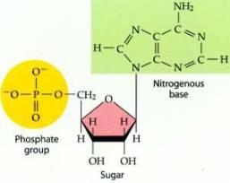
Basic structure of a nucleotide
teachernotes.paramus.k12.nj.us

Slide 14
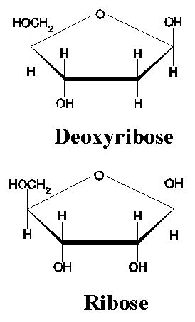
Nucleotides are monomers made of three parts.
1. a sugar (deoxyribose or ribose)
www.layevangelism.com

Slide 15
2. a phosphate group composed of one atom of phosphorus surrounded by four oxygen atoms
4.bp.blogspot.com

Slide 16
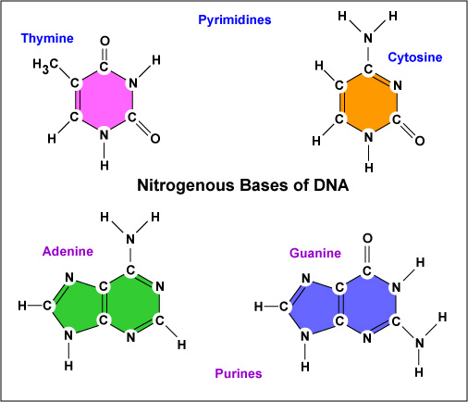
3. A nitrogen base. There are four that make DNA. (A, T, G, C)
student.ccbcmd.edu

Slide 17
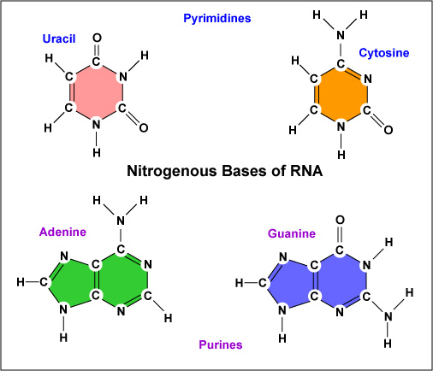
3. There are four that make RNA. (A, U, G, C) Uracil replaces thymine.
student.ccbcmd.edu

Slide 18
DNA RNA
student.ccbcmd.edu

Slide 19
In a DNA molecule, sugar and phosphates act as the “backbone” of the molecule and the nitrogen bases meet in the middle.

Slide 20
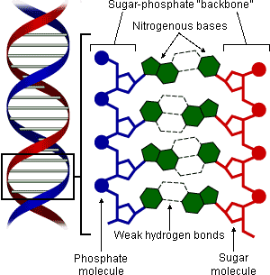
evolution.berkeley.edu/.../dna_structure.gif

Slide 21
The nitrogen bases connect in the middle by weak hydrogen bonds.
A connects to T
C connects to G

Slide 22
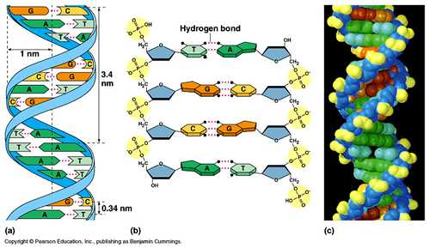
A’s always attach to T’s, and G’s always attach to C’s by weak hydrogen bonds.

Slide 23
The order of these A’s, T’s, G’s, and C’s are the codes for our genes. Scientists have mapped human chromosomes. These maps are called the “Human Genome.”

Slide 24
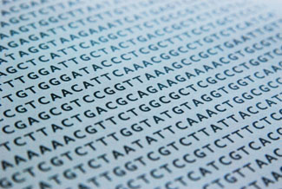

Slide 25
The four bases are used as a code to carry genetic information like a computer uses binary language. The human genome is a list of the sequence of all these bases.

Slide 26
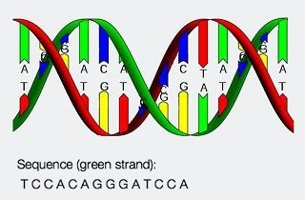
A
snpsandchips.com

Slide 27
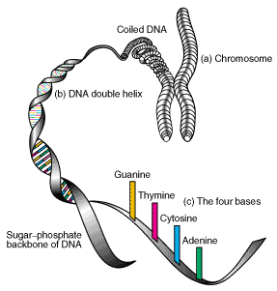
llnl.gov

Slide 28
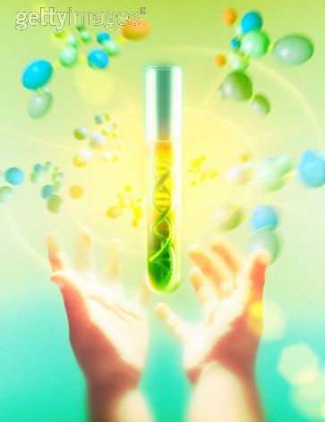

Slide 29
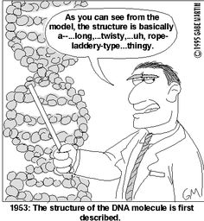

Slide 30
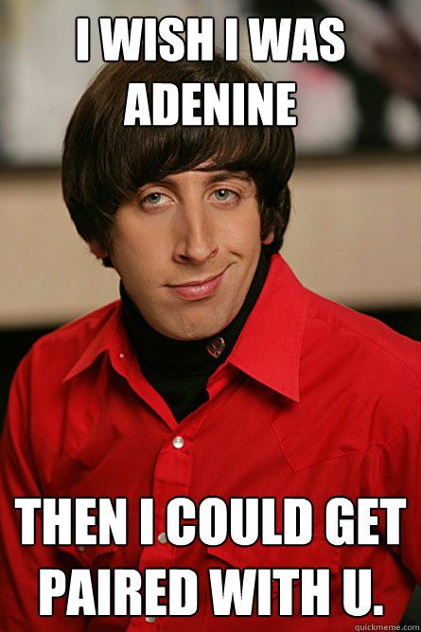

Slide 31
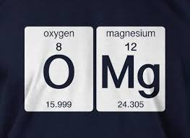
I heard that oxygen and Magnesium were going out and I was like….

Slide 32
