Slide 1
Welcome!!
Find your name on the table and have a seat.

Slide 2
Biology
Fall 2019
Mrs. Kristy Smith
ksmith17@wcpss.net
hshsksmith17.weebly.com

Slide 3
About Mrs. Smith
Graduated from Denison University in Granville, Ohio with a Biology Degree
Taught math for 10 years
Taught at Holly Ridge Middle School – 6th, 7th, & 8th grade- before coming to HSHS
My husband also works here at HSHS
We have two sons, Henry (7) & Ollie (3.5)

Slide 4
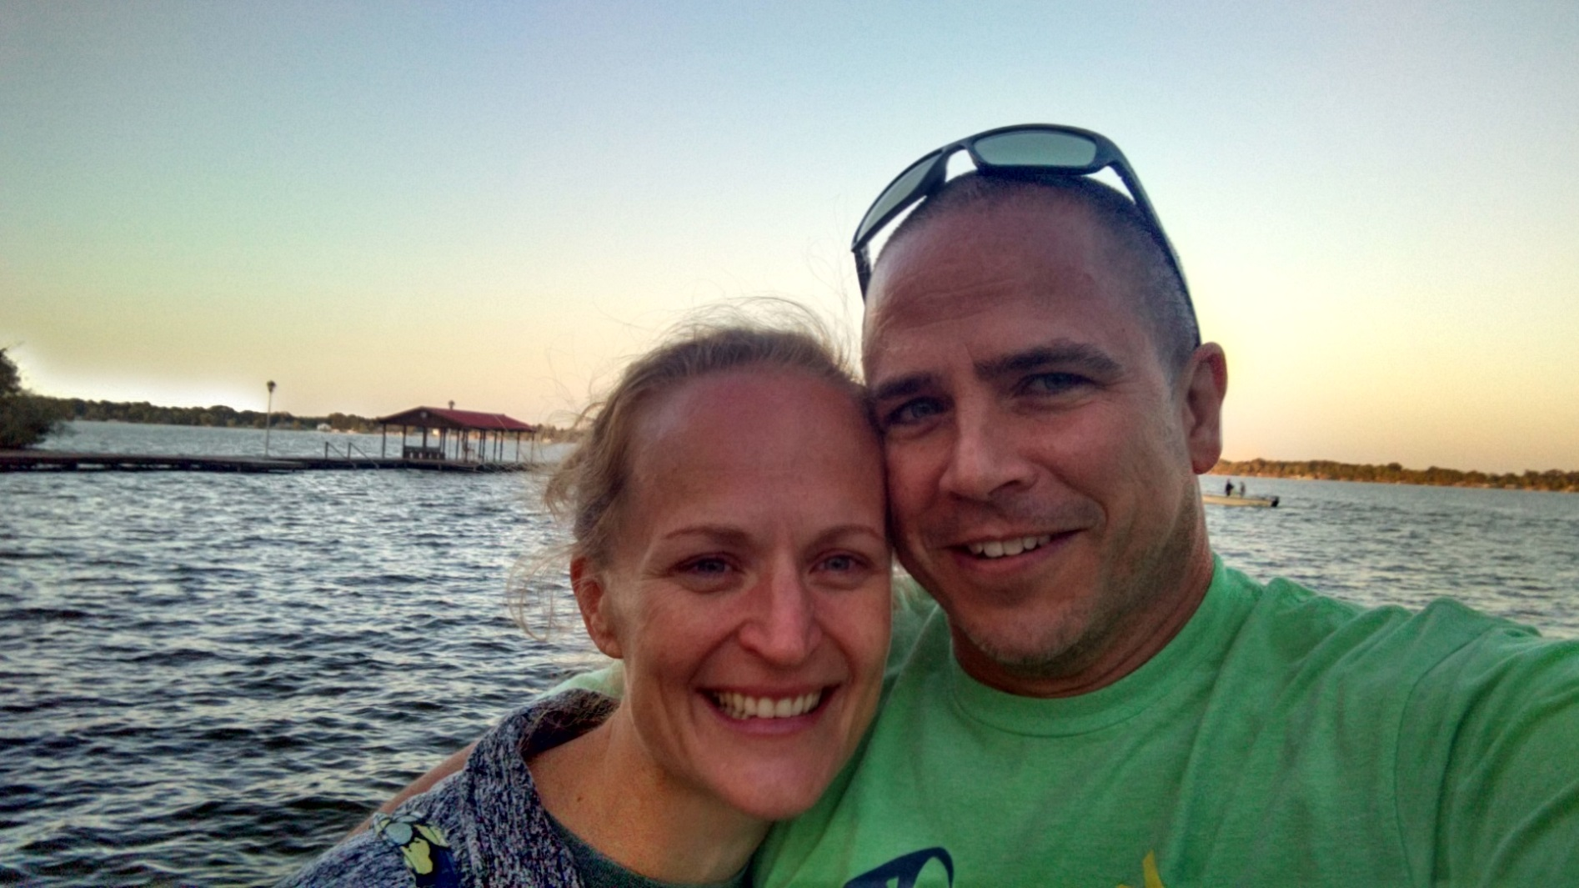
The Family

Slide 5
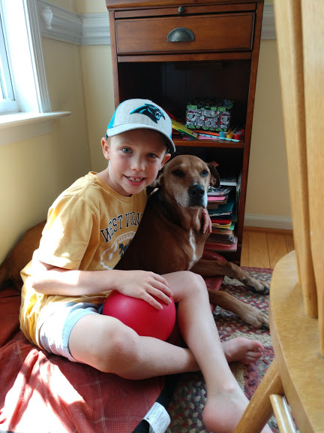
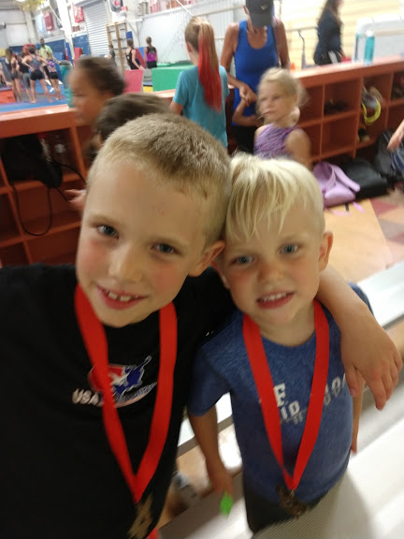
The Family

Slide 6
About Mrs. Smith
Avid runner and triathlete
  Completed 4 marathons including Boston
  Finished numerous 200-mile relay races as 12 & 6 person teams in Oregon, Massachusetts, New Hampshire, North Carolina, Michigan, Indiana, & California
  Completed the Tuna Run 70 as a 3 person team two times.
  Done 3 half-ironman triathlons and numerous sprint and Olympic triathlons

Slide 7
About Wonderful You….
1. Your name (what you like to be called)
2. Interests outside of school
3. Family (pets, siblings, parents/guardians, etc)
4. Biggest accomplishment
5. Pet peeves
6. Anything else you would like me to know

Slide 8
Warm Up
What is Biology? Why should you take this class other than it is required?

Slide 9
Warm Up
What is the independent variable of an experiment? What is the dependent variable?

Slide 10
Basic Laboratory Equipment

Slide 11
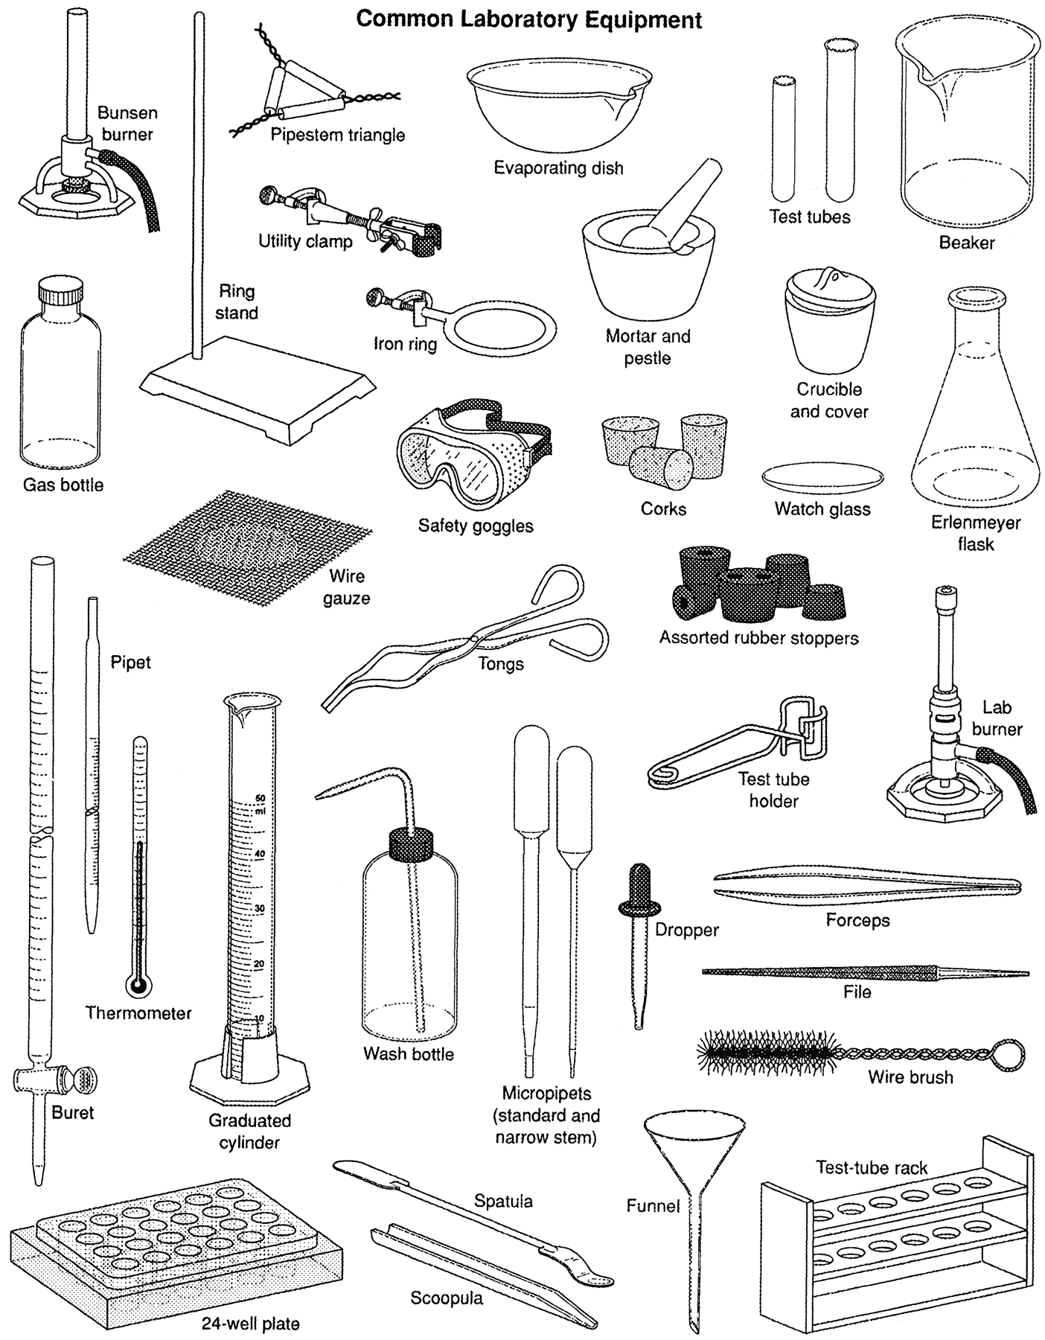
You may be using many of these common lab materials throughout the semester.

Slide 12
Lab Safety
What are the potential hazards?
Broken glass
Spills
Fire
Electrical shocks
Can you think of other hazards?

Slide 13
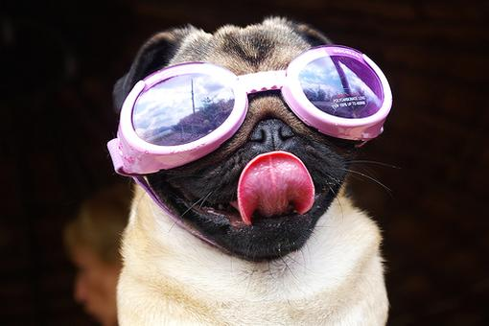
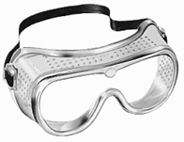
Before you begin any lab activity:
Put on your goggles! They may be ugly but they could save your sight.
myfunnypics.org
edshouseofgems.com

Slide 14
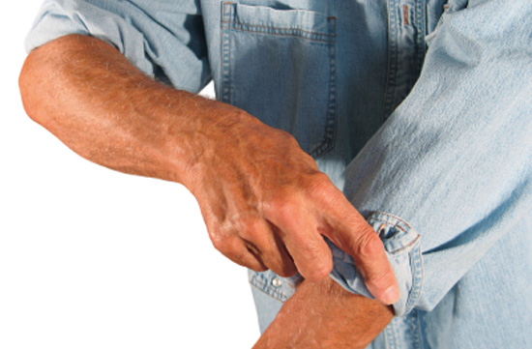
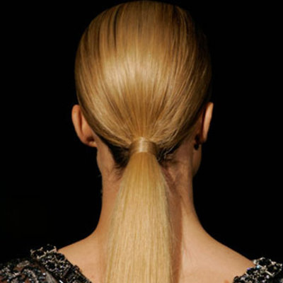
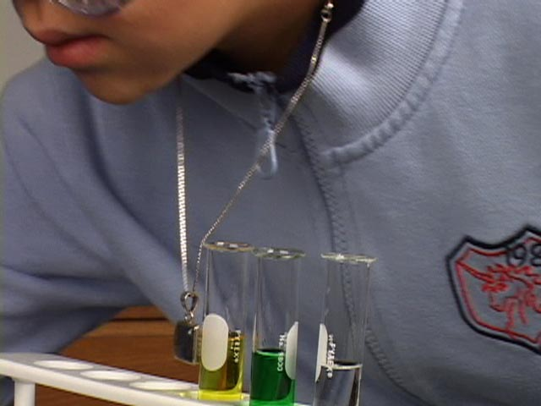
Before you begin any lab activity:
content.fibers.com
www.realbeauty.com
Remove, tie back, or roll-up any loose clothing, jewelry, or long hair .
video.ecb.org

Slide 15
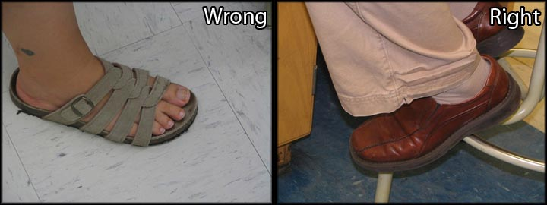
Before you begin any lab activity:
Wear shoes that cover your feet.
teaching/bio/pics/labshoes.jpg

Slide 16
Lab Safety
How do I safely manipulate materials and equipment and conduct appropriate procedures?
Follow safety rules covered at the beginning of the year.
Know these rules!
Follow teacher instructions.
What else applies?

Slide 17
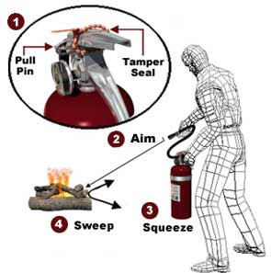
Safety Equipment
Fire Extinguisher Aim the extinguisher at the base of the fire.
www.osha.gov

Slide 18
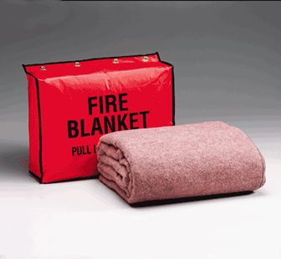

Safety Equipment
Fire Blanket Use the blanket to smother a fire of someone’s clothes.
chemistry.about.com
www.agrymarine.com

Slide 19
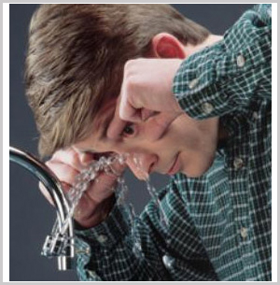
Safety Equipment
Eyewash If you get anything into your eyes, place your face over the eye wash and rinse for 15 minutes.
globaleyeglasses.com

Slide 20

How to Use a Microscope

Slide 21


Slide 22
